Slide 1
THE BLOSSOMS
Group Presentation

Slide 2

SLYDEHUB
Android Portable Library
By The Blossoms

Slide 3
WHAT IS SLYDEHUB ?
SLYDEHUB is an android mobile application made by incorporating mysql alchemy, python flask and flutter codes to create a simplistic user friendly interface for KNUST Engineering students.
The Application is a portable library that is presented in an easy to use, reliable, free to download and easily accessible format.
It aims to be the primary choice for distributing and accessing lecture materials for all members of the KNUST College of Engineering.

Slide 4
APP FEATURES
The application features a vast array of lecture materials for all engineering courses offered in KNUST in the various semesters and years.
Some of these include:
Lecture slides
Pdfs
Books for various courses
Links for supplementary Youtube videos
Downloadable content

Slide 5
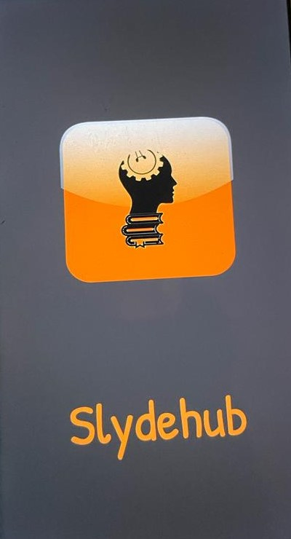
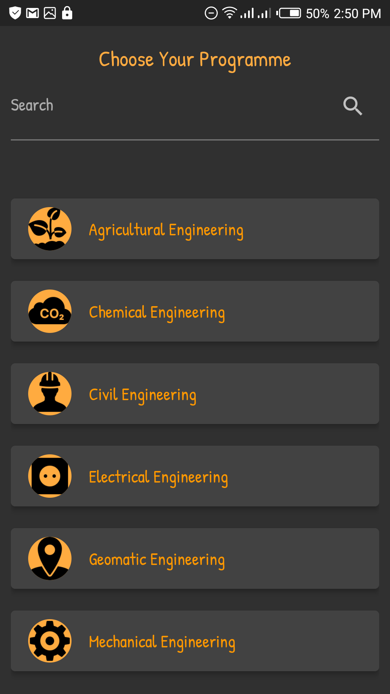
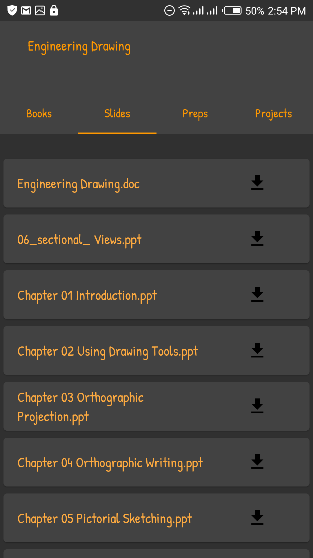
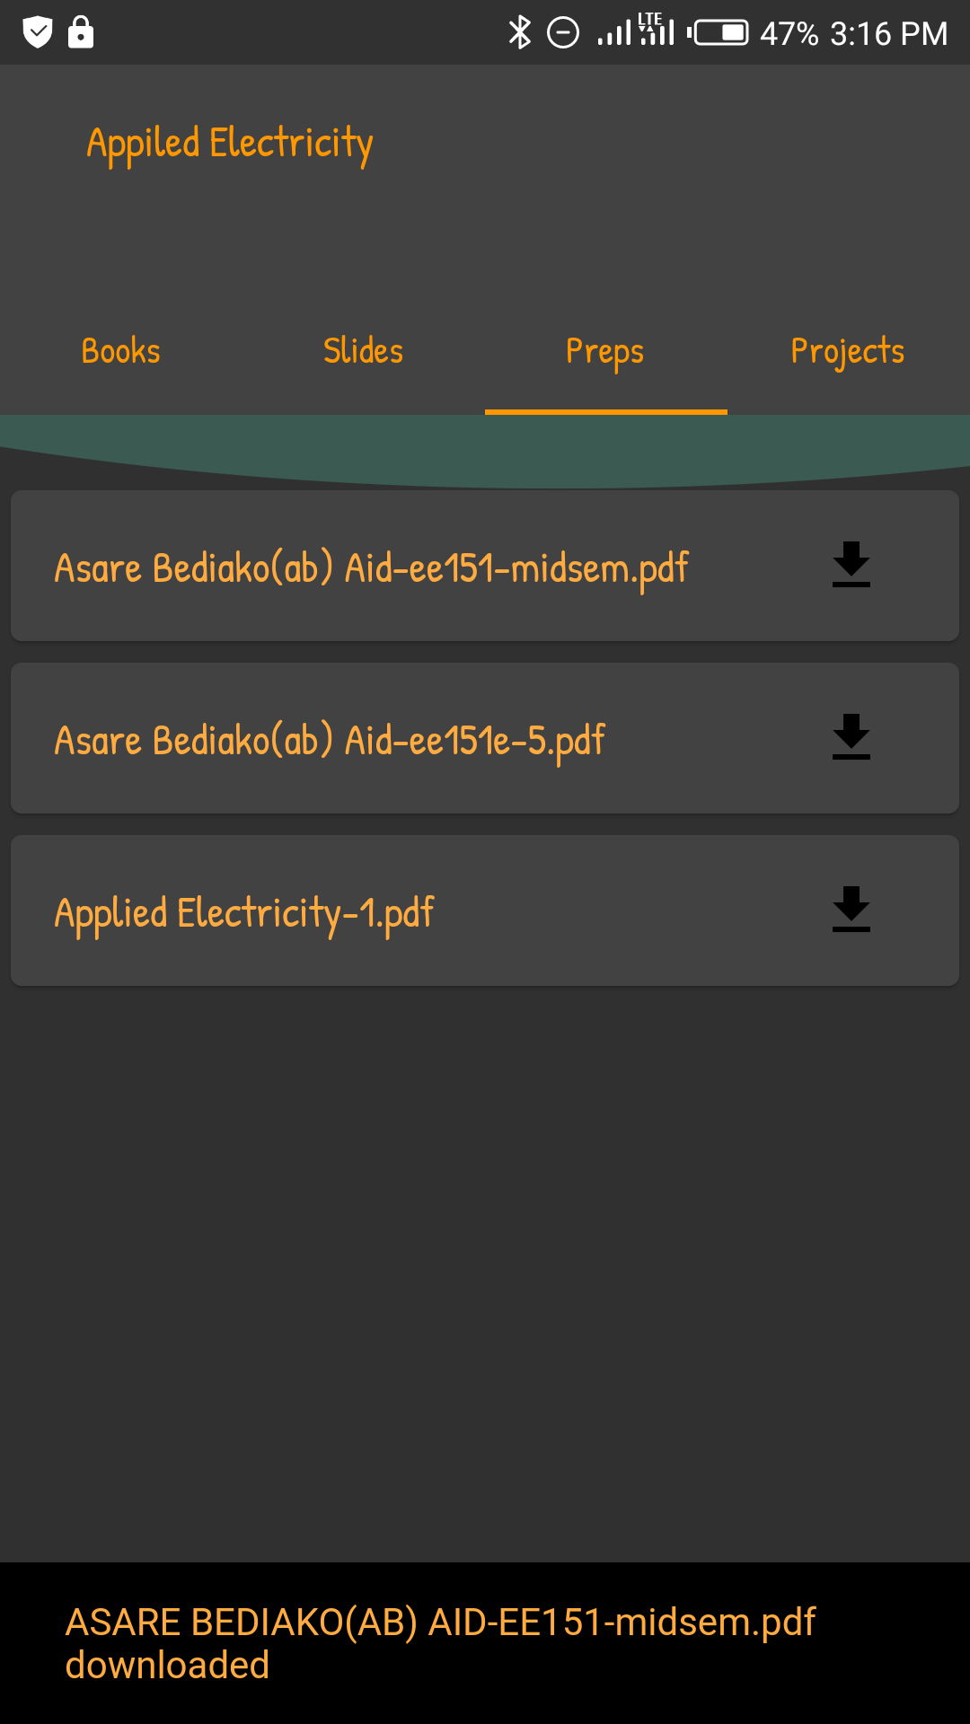
SLYDEHUB

Slide 6
WHY SLYDEHUB?
SLYDEHUB first came about after a handful of complaints by first year students of Kwame Nkrumah University of Science and Technology on their struggles to find a reliable and convenient source for lecture materials.
Further investigations of these complaints revealed they were not only limited to first years, as a number of continuing students also raised similar concerns.
As students, this was an issue we could easily relate with and we asked ourselves, WHY don’t we do something about this?
We limited our goal to only Engineering students in KNUST as it was a much more realistic task within the set time limit. “Simplicity is the ultimate sophistication” after all

Slide 8
WHAT SLYDEHUB DOES?
SLYDEHUB was made with the primary intention of making private studies easier for students
It allows students to study at their own pace by giving students access to course materials well before hand.
It provides an ever expansive learning environment for students to engage in conducive learning
SLYDEHUB also provides additional earning materials such as links to YouTube videos and tutorials to make student learning more enjoyable and efficient.

Slide 9
HOW TO USE SLYDEHUB
The best applications are the ones that provide useful resources in a very simple and easy to access format.
As such the mobile application has a user friendly environment that is very easy to use.
Simply login/sign up on the login/sign up page select the program you’re offering and select the year and semester. Pick the course you want to learn and choose the book, pdf or slide you want to use.
It is recommended that you download the material you will like to use to be able to use it offline.

Slide 10
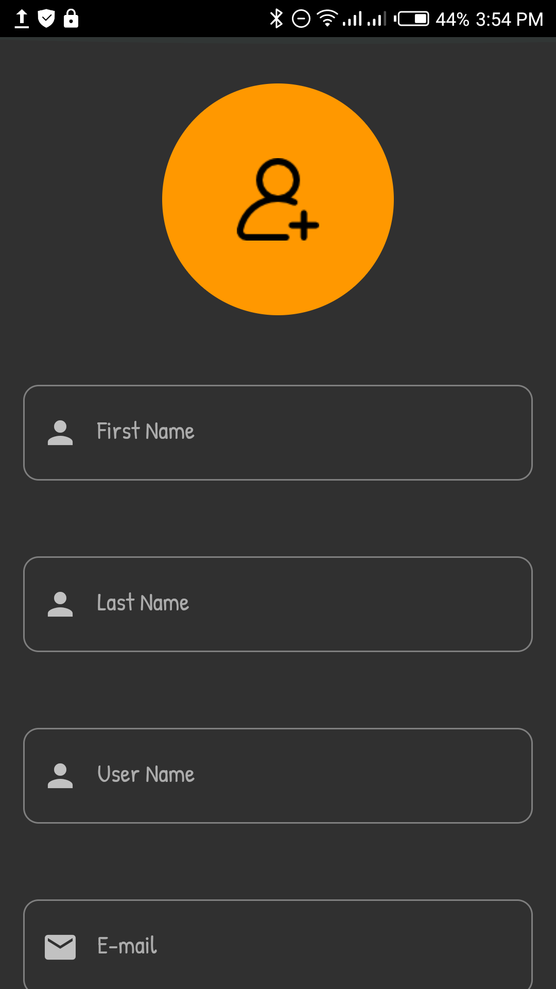
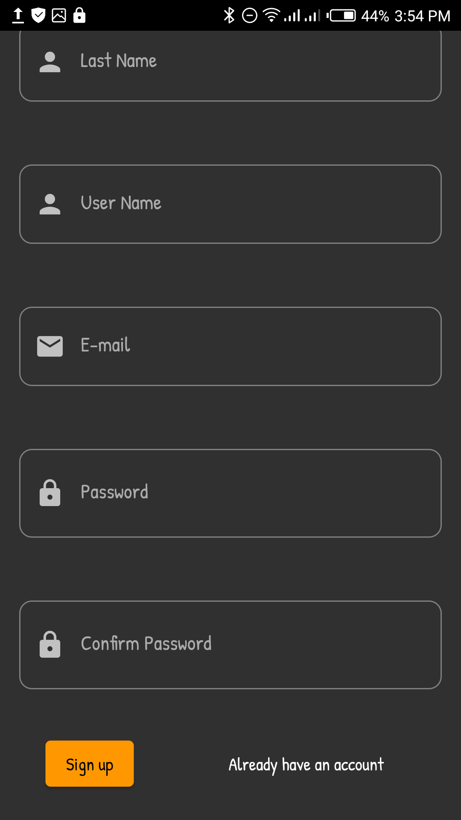
SIGN UP

Slide 11
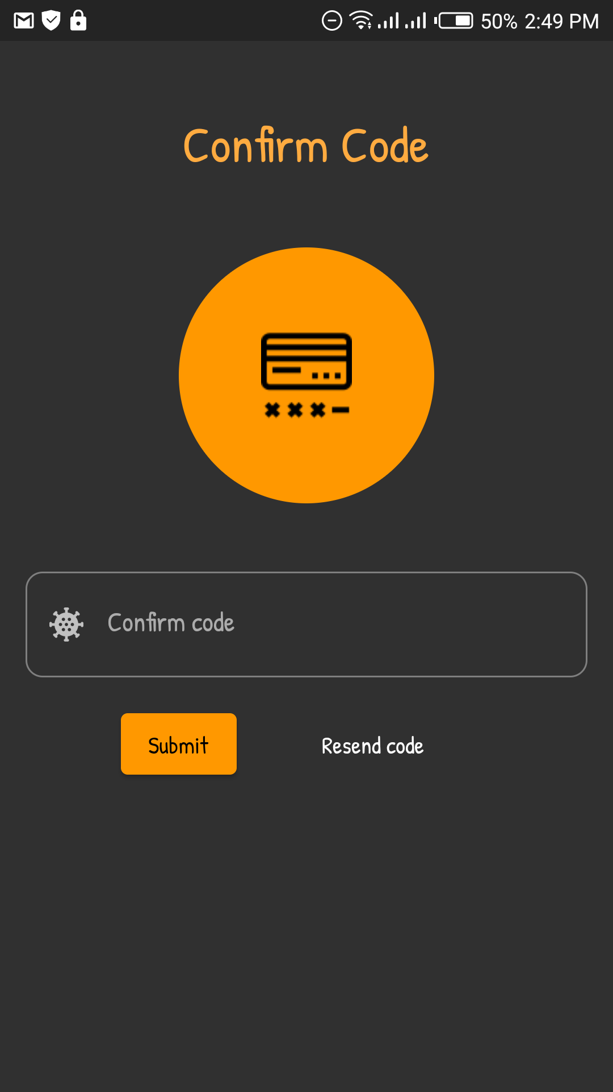
VERIFY YOUR EMAIL

Slide 12
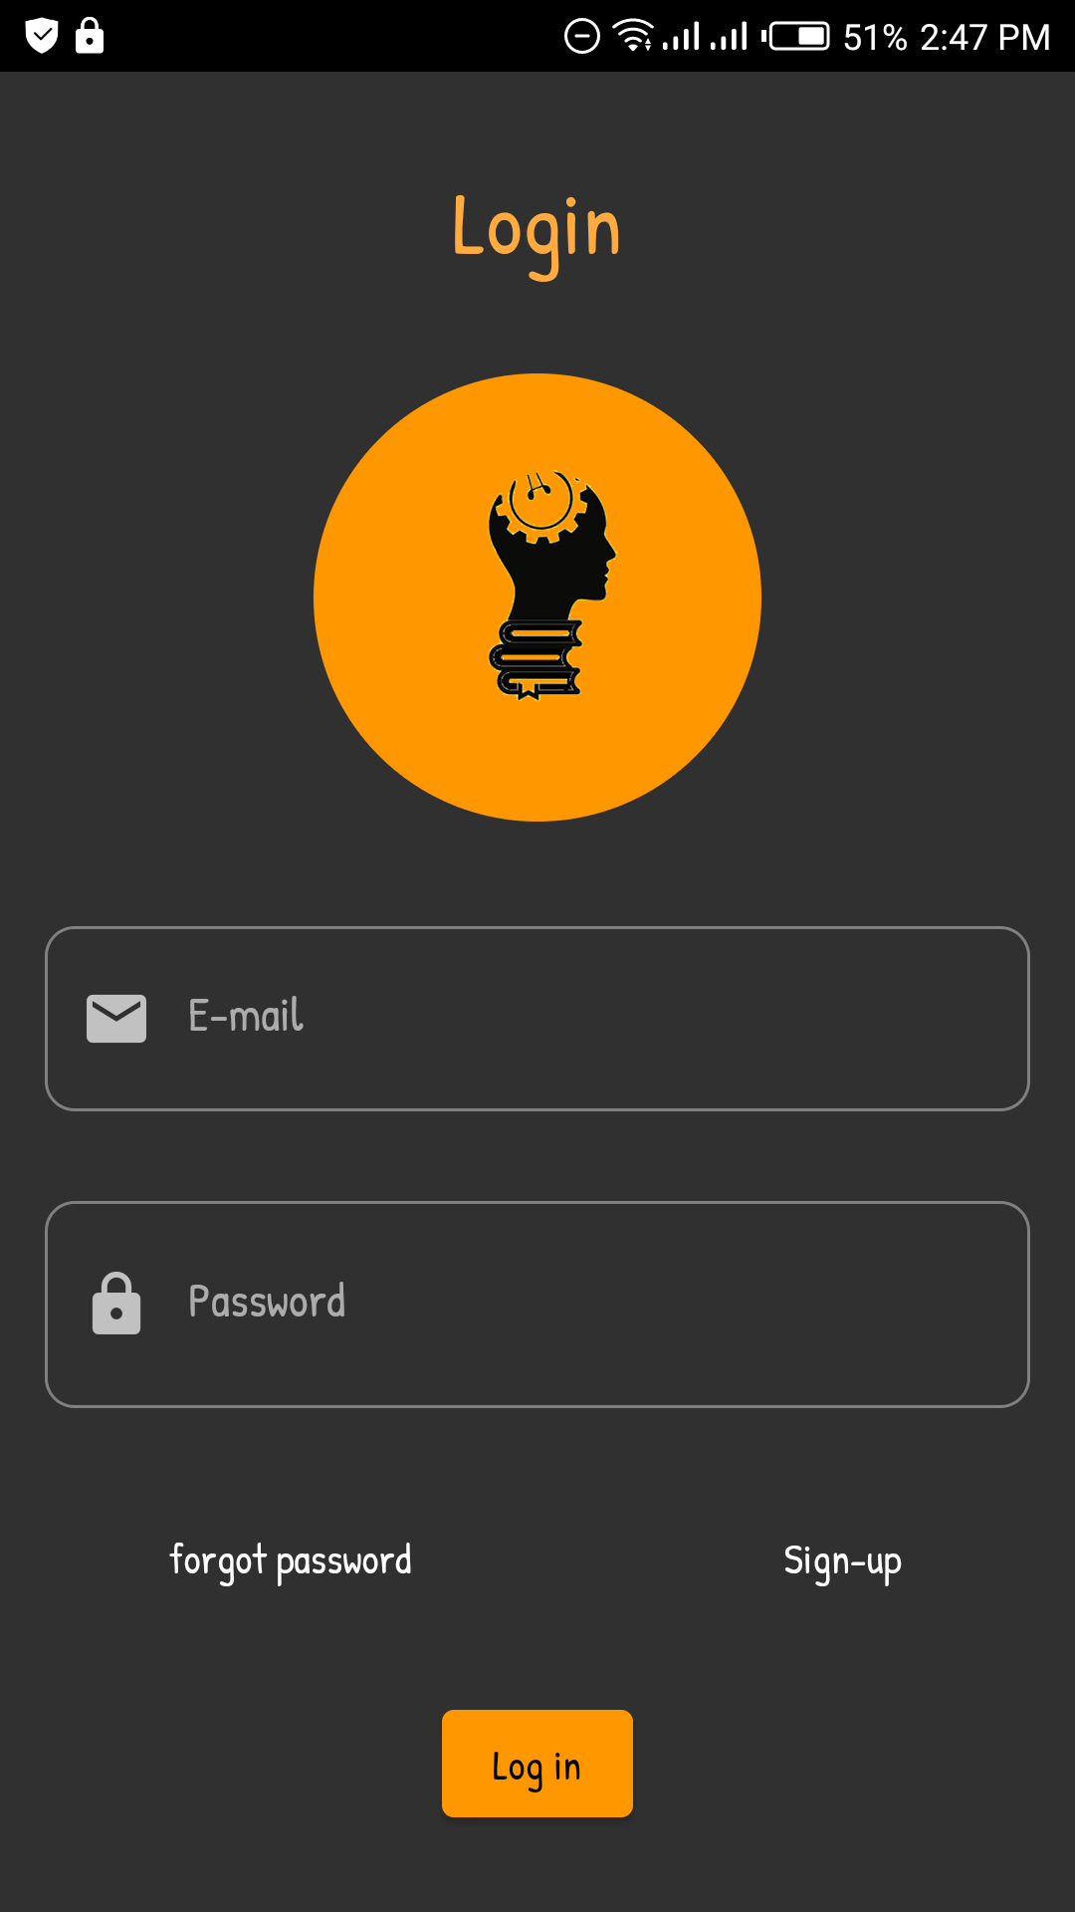
LOGIN

Slide 13
SELECT PROGRAM

Slide 14
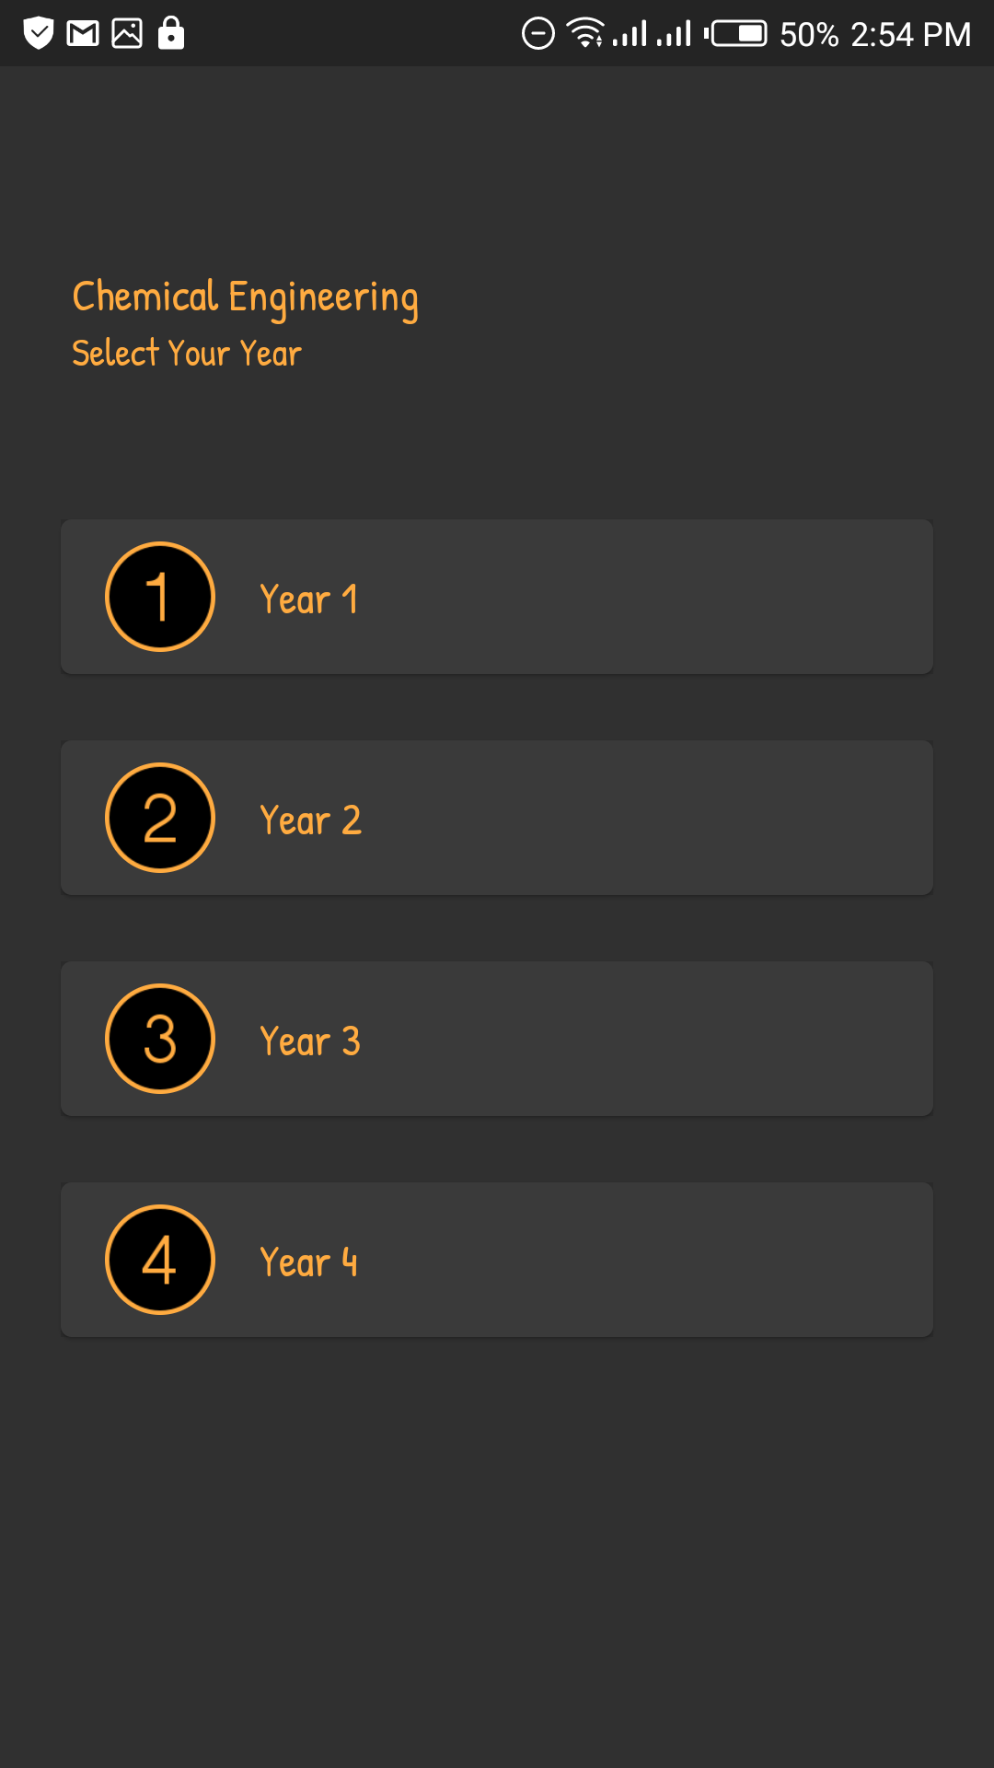
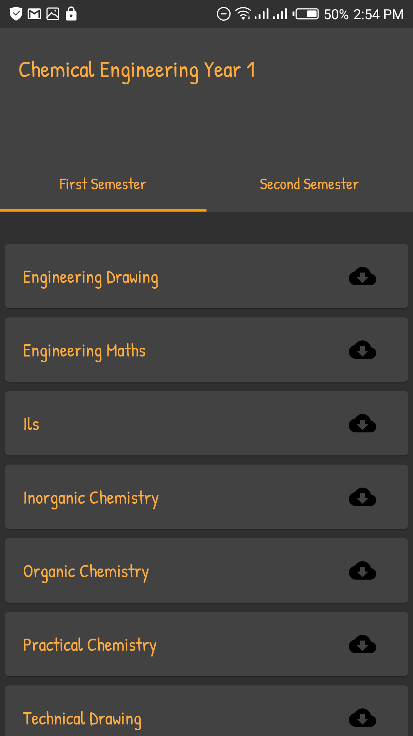
SELECT YEAR AND COURSE

Slide 15
SELECT FROM THE ARRAY OF COURSE MATERIALS

Slide 16
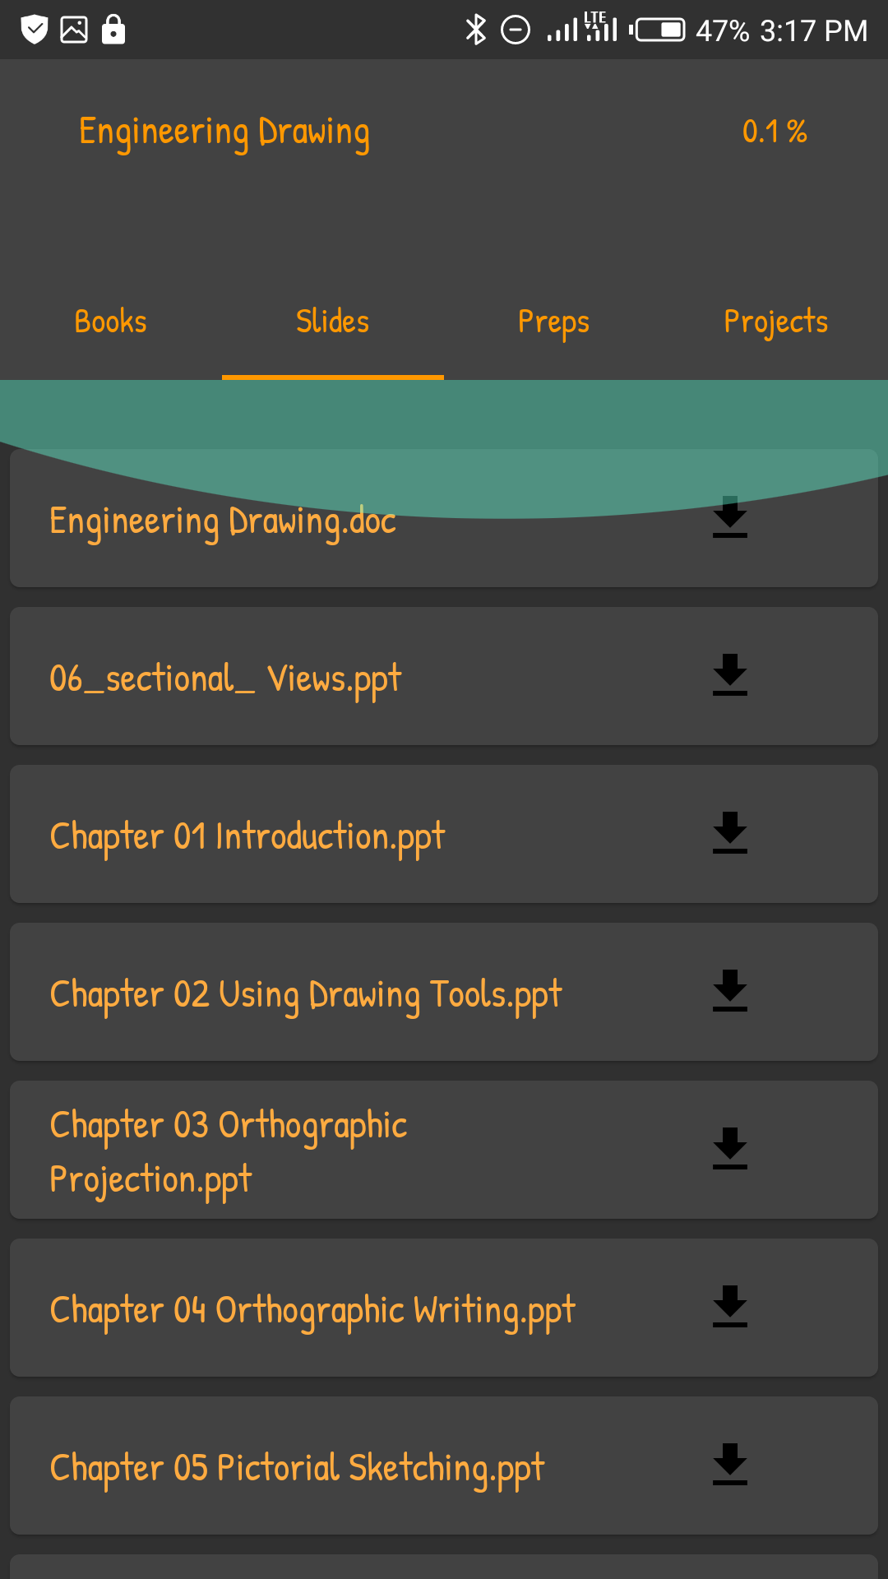
DOWNLOAD WHAT YOU NEED

Slide 17
WHY YOU SHOULD DOWNLOAD SLYDEHUB?
SLYDEHUB is a portable library that is easy to use, reliable, free to download and easily accessible.
Application will make access to lecture materials much more convenient for new and continuing students.
Application will make private studies much easier for students.
Application allows students to prepare ahead of time as they will have lecture materials for future semesters well ahead of schedule.
Even though the application was created for engineering students we still hope to grow the app to be for all students in KNUST and perhaps even beyond.

Slide 18
ABOUT CREATORS
SLUDEHUB was created by The Blossoms with the aim of making private studies for themselves and fellow students much more effective and conducive.
The Blossoms team consists of ten third year Computer Engineering students working tirelessly.

Slide 19


OUR TEAM
Etorna
Project Manager
Backend head
Frontend head

Slide 20

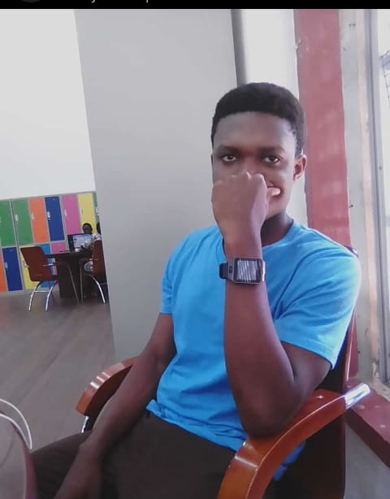

OUR TEAM
Abena Koramah Asiedu
Samuel Frimpong
Perry Terry Darku

Slide 21



OUR TEAM
Dan Serebo Quaicoe
Ebenezer Afriye

Slide 22

OUR TEAM

Slide 23
THANK YOU !
SLYDE away

